Slide 1

NATIONAL INSTITUTE OF TECHNOLOGY JAMSHEDPUR
DEPARTMENT OF COMPUTER SCIENCE AND ENGINEERING
An Epistatic Study on Fitness Landscape of Job
Shop Scheduling Problem
Under the guidance of :
Dr. Vinay Kumar
Assistant Professor
Dept. of CSE
NIT Jamshedpur
By :
Aditi Biswas Purba
(2016UGCS096)

Slide 2
Problem Statement
The JSSP has become the most attracting, popular scheduling problem to the researchers as it has mass aptness and implicit drawbacks. It has n jobs being processed on m machines with predefined processing time and routing orders.
All the researchers have been working on the minimization of the makespan and fitness values of the jobs or machines. But there may be some dependencies among the jobs or machines. This dependency is known as epistasis where each job is actually interacting with others.
We have chosen a problem where we will analyze the performance of epistatic interaction of local search techniques on the permutations of job shop scheduling.

Slide 3
Motivation
Being a NP hard optimization problem, Job shop scheduling problem cannot be solved in polynomial time with any algorithm. But some approximation algorithms can perform better but it also requires micro level analysis of the solution landscape to observe the possible performance based on some variants. Epistasis is a genetic measure of effects of mutation on genotypic aka problem solution spaces. It is very efficient in the study of ruggedness and neutrality of the fitness landscape. Our motive is to analyse job shop scheduling problem hardness through epistatic measures for algorithm selection of the same.

Slide 4
Objectives
Job Shop scheduling problem formulation by Random Walk method that includes neighbourhood structure and factorial representation.
Calculation of Epistatic measurement.
Fitness Landscape analysis of fitness values and epistatic measures.
Analysis of the performance of the calculated solution from different neighbourhood structures.

Slide 5
Related Works
By creating parallel representation of chromosome and genetic operators, performance of JSP can be improved through parallel machine and job encoding.
A concept of epistasis with two decidability and bit decidability has been considered for finding the higher order epistasis value for a particular fitness function of NP-hard problems.
Big valley structure using factorial representation and neighbourhood structure improves the searchability of local optimas.
By the correlated solutions from the ruggedness of the fitness landscape, amount of epistasis can be analysed.
Fitness landscape analysis can actually obtain the insights into problem classes through search space fitness function, landscape variants, spectral analysis, basin analysis, epistasis, neutrality etc.

Slide 6
Proposed Methodology
Factorial Representation :
In combination mathematics, factorial number representation can be used to generate a decimal number for a particular permutation where t will be the number of digits in a permutation and range will be 0 to (t!-1). It was first proposed by Laisant and he stated that each permutation of n digits will have a unique decimal number which will represent that particular permutation. Following steps will be done :
1. Initialization of JG = {0,1,2,...,t} , L = {1,2,3,...,t}, fact={}, Fac = 0, j = 1
2. do
position = Binarysearch (L[j]==J)
fact[j] = JG [position]
Removal of P[position] from L
Fac = Fac + fact[j] * JG [t-j+1]!
j = j + 1
while(j <= t)

Slide 7
Proposed Methodology
2. Neighbourhood Structure :
A neighborhood structure is one of the mapping functions where the neighbourhood operator is actually moving an element of the existing solution by performing a small movement.
The main motive is to enhance the efficiency of the local finding in the neighbourhood. To create more solutions from the selected neighbourhood, classical neighbourhood structures such as insertion neighbourhood structure (INS), swap neighbourhood structure (SNS), reversion neighbourhood structure (RNS), block-shift neighbourhood structure (BNS) can be considered.

Slide 8
Proposed Methodology
2. Neighbourhood Structure :
From the INS neighbourhood structure, such jobs or machine permutations are created where the x^{th} operator is removed and is inserted after the y^{th} operator where x ≠ y and x ≠ y + 1. The SNS neighbour is actually obtained by swapping the x^{th} and the y^{th} operator with x ≠ y. In the RNS neighbourhood, operators are swapped and the operators between the swapped operators are reversed. In the BNS neighbourhood, k consecutive operators are removed from the position a i.e a < n - k + 1 and reinserted into position b where b > 1 + a - k or a > b.

Slide 9
Proposed Methodology
3. Epistasis :
The measurement of epistasis was first proposed by Davidor in 1990 where it was said that a linear function can be considered as a fitness function if it doesn't have any epistasis and the amount of epistasis is called epistasis variance.
Epistasis can be introduced as a generalization process of investigating between one or more locations on a chromosome, having a concept of the fitness landscape, where it gives a more proper resolution.
Epistasis expresses correlation between the bits and optimal bit decidability along with the large classes of the function.

Slide 10
Proposed Methodology
3. Epistasis :
To calculate the amount of non-linearity in a representation, Davidor has introduced a variance where the probability of the fitness of a chromosome decreases with the increment of the dimension of reciprocal action among various locations.
The measurement of epistasis in the fitness landscape can be expressed as correlation, 𝛄.It is a physical amount of local dependency. The range of lies between 1 and -1.
From correlation, the effects of epistasis in the fitness landscape can be seen in three types of epistatic interactions which are magnitude epistasis, sign epistasis, reciprocal epistasis.

Slide 11
Result and Discussion
All experiments have been carried out on Intel i5 dual core CPU and Windows 10 with Python 3.7 with the aid of Jupyter notebook. We have considered the three cases of job shop scheduling as for abz5 [28], la37 [29] and yn1 [30] as the benchmark. The benchmarks, abz5 (10 x 10), la37 (15 x 15) and yn1 (20 x 20) have the order of machines of every job along with the processing time of every machine of every job. We studied 10000 random solutions through a random walk described below:
Generate a random solution from the problem space.
Calculate the fitness of the answer and store it with the present answers
factorial representation.
While ending criteria not met, do:
Generate a sample feasible answer set of the current answer based on
different neighborhood definitions.
Elect an individual answer randomly from the sample answer set.
Calculate the fitness of the answer and store it with the present answers
factorial representation.

Slide 12
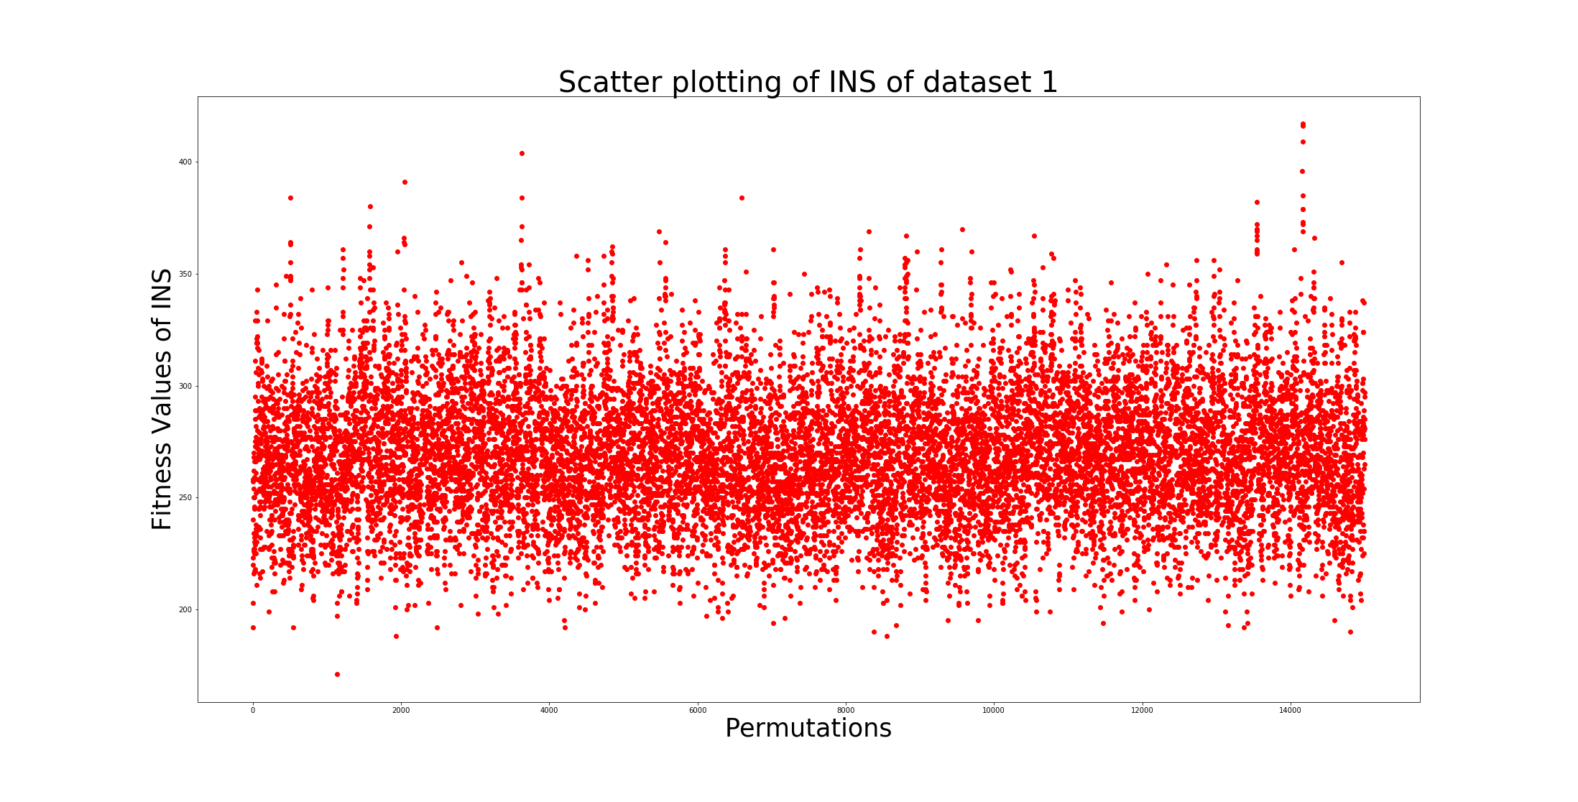
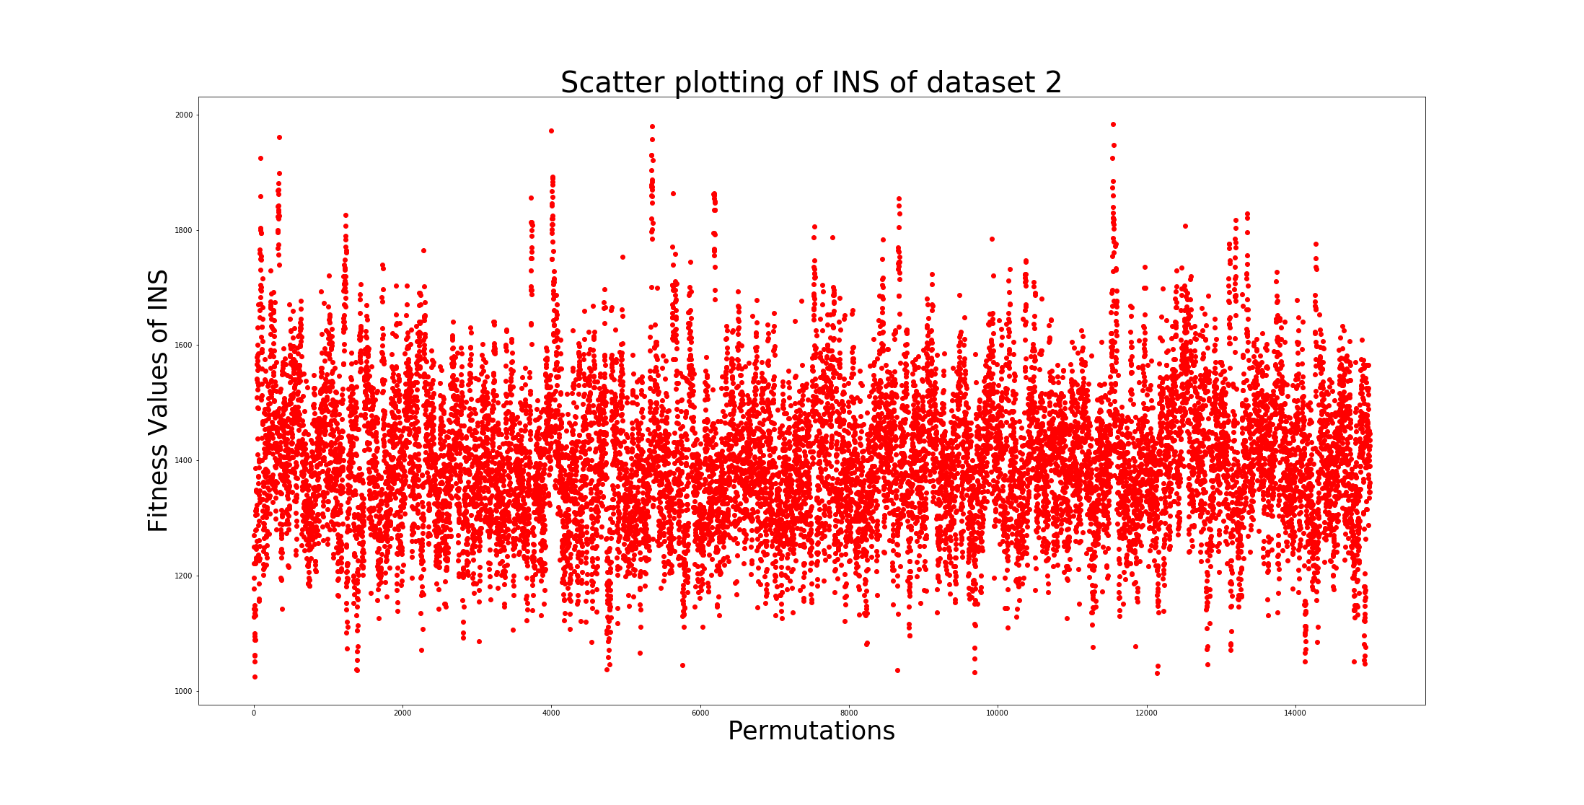
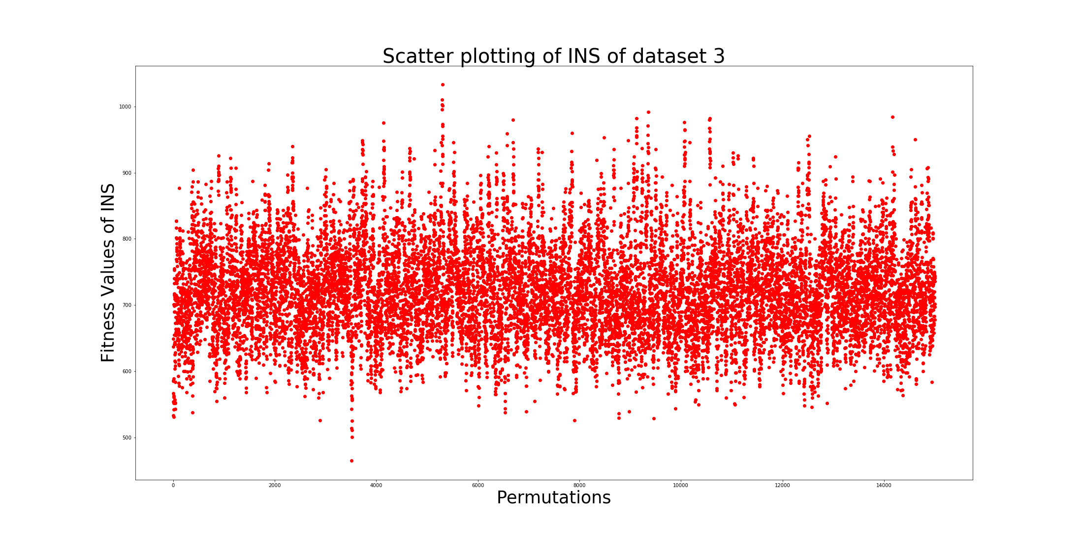
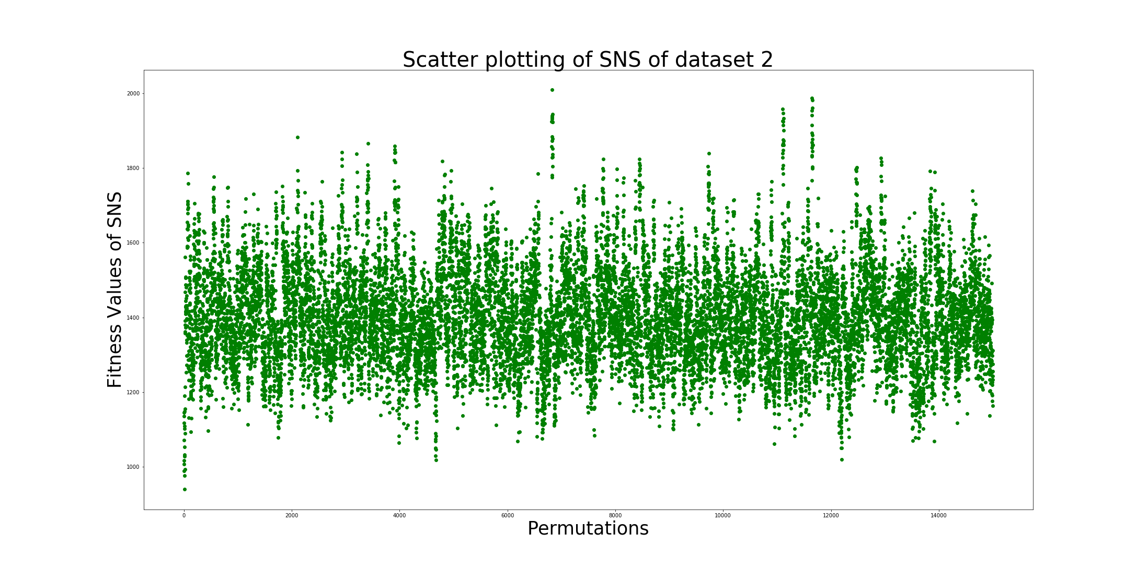
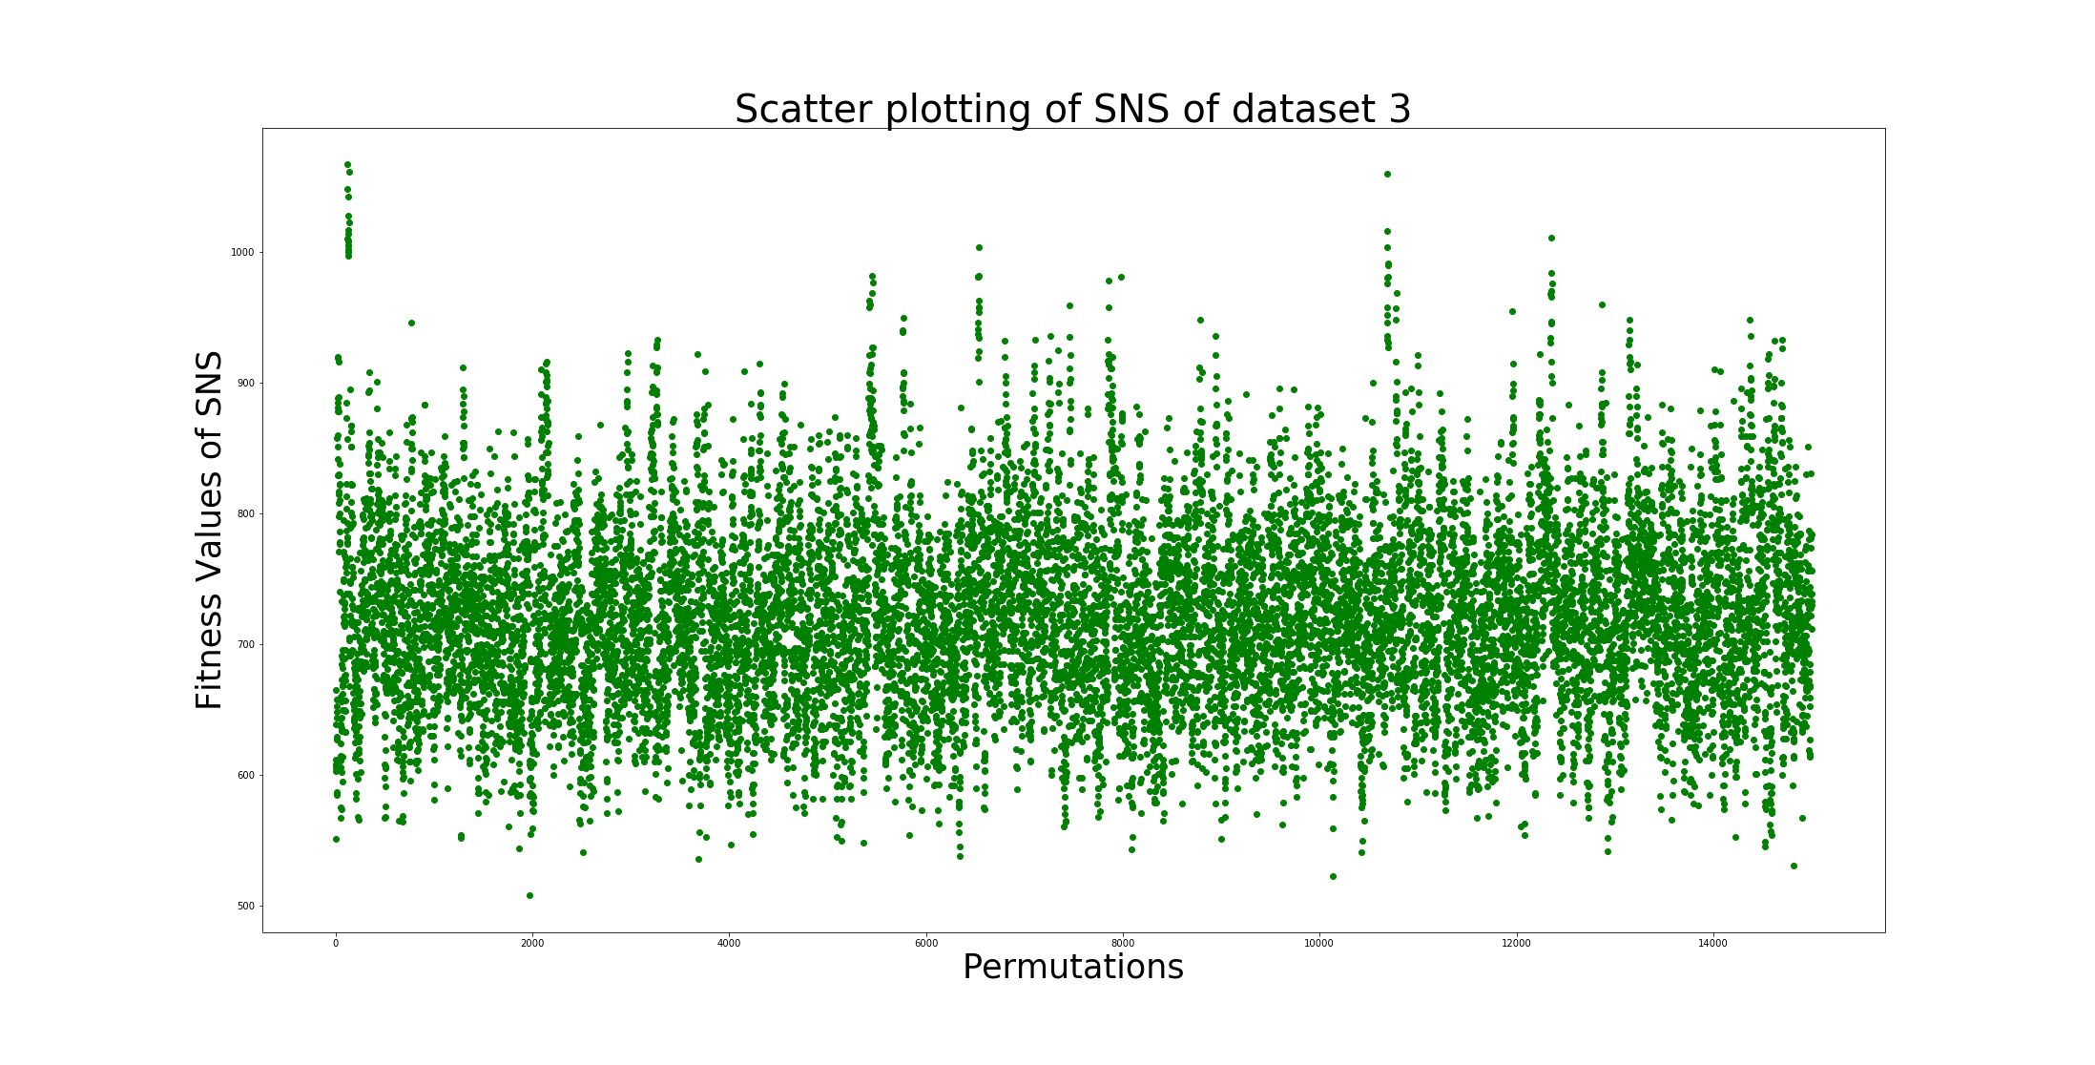
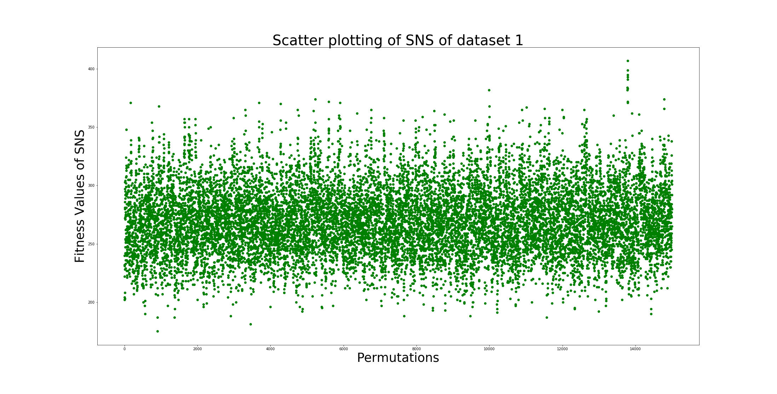
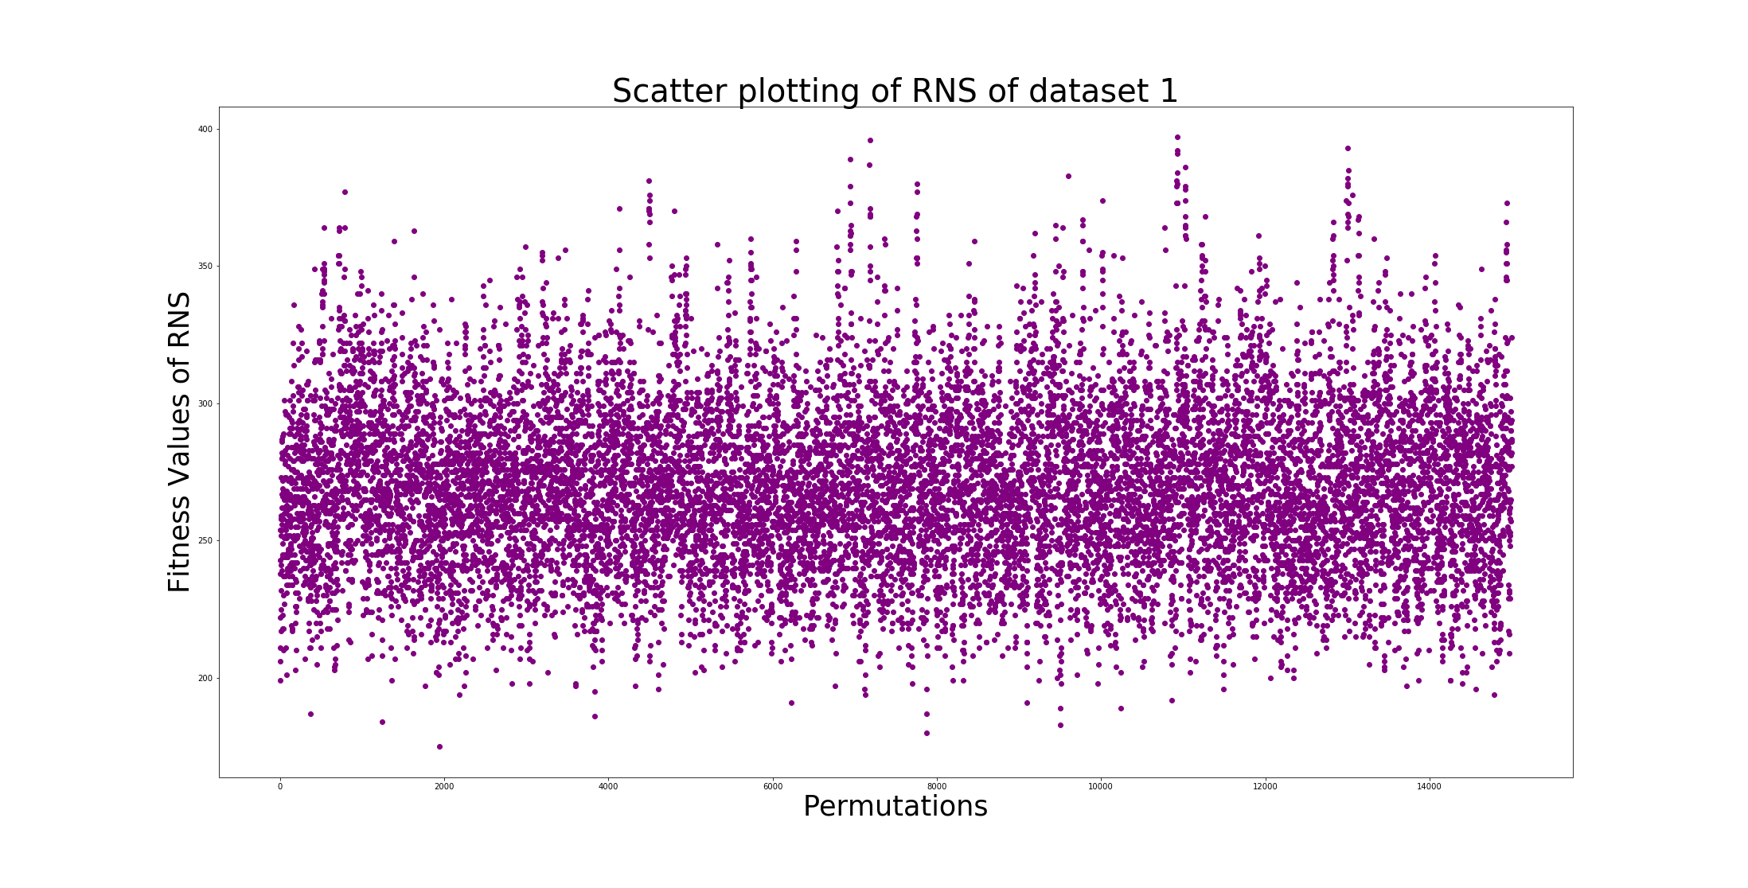
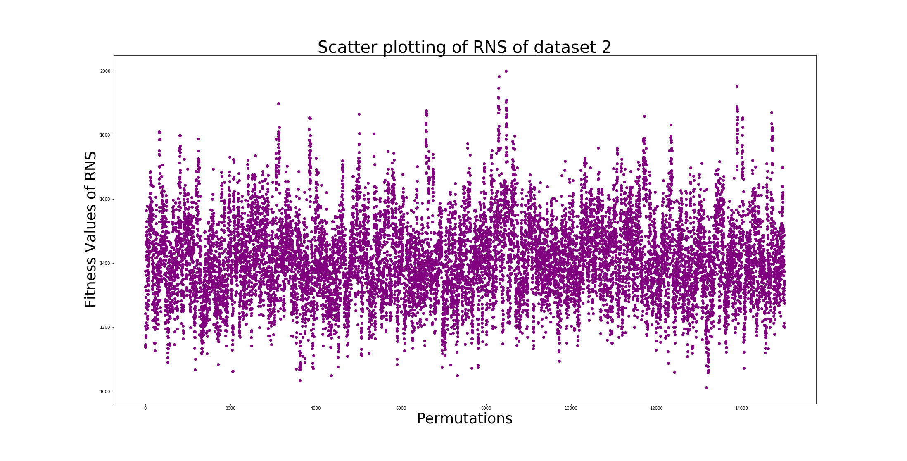
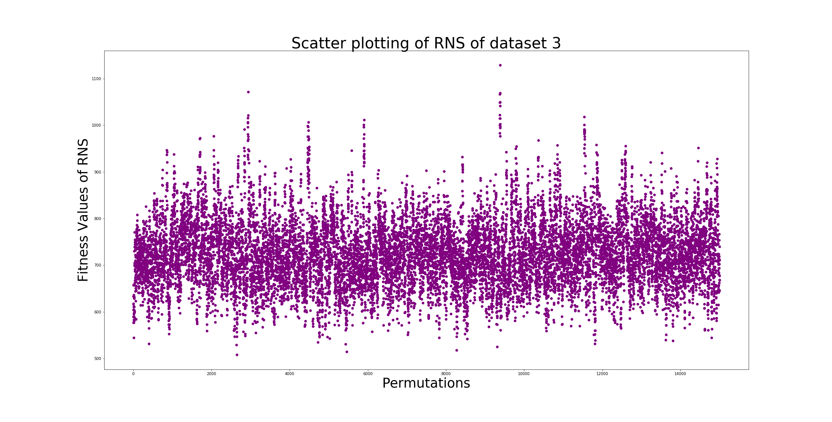
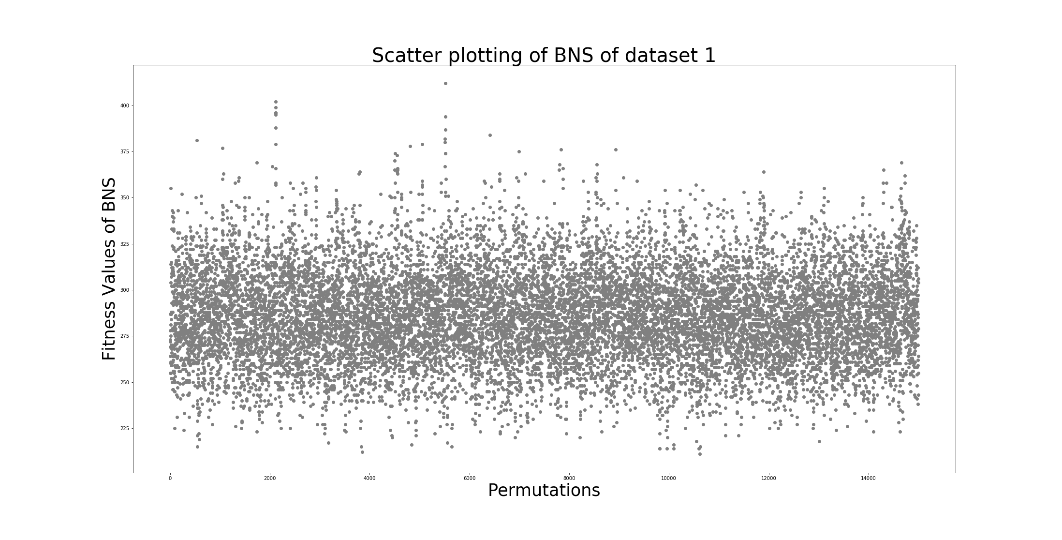
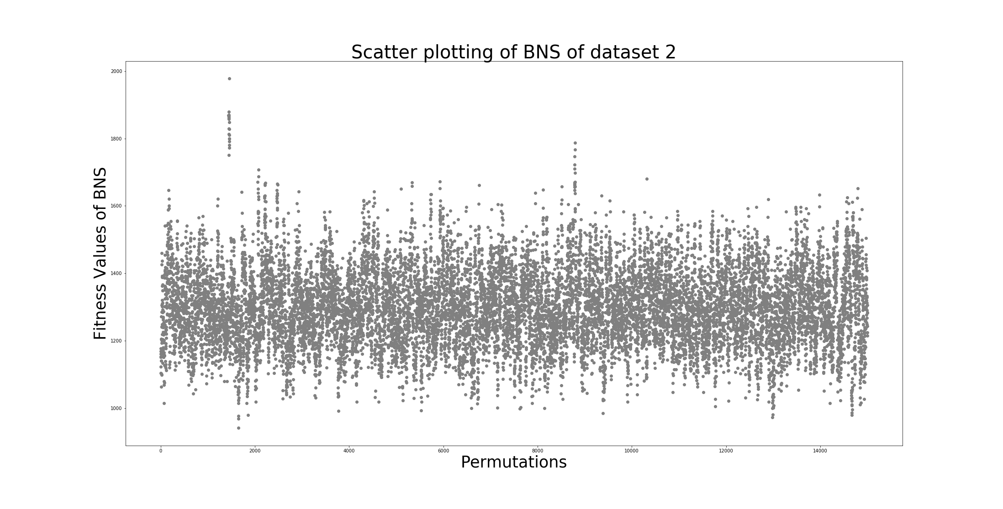
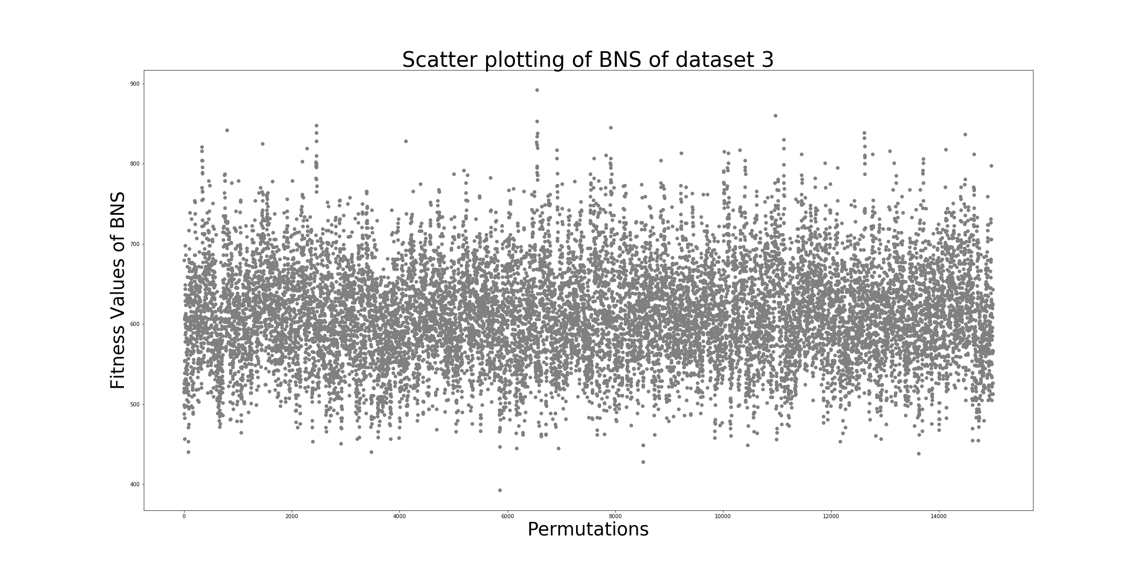
Result and Discussion
Makespan distribution for 3 benchmarks for BNS, INS, RNS and SNS respectively

Slide 13
Result and Discussion
The above procedure utilizes RNS, INS, BNS, and SNS neighborhood structure. To generate the neighborhood sample from a current solution we have considered the sample size would be 50.
After that a random solution is being selected as the current one for the next iteration. The random solutions’ makespan are graphically displayed by selecting 10% solutions randomly of the sample to observe the fitness distribution of the specified problem.
It has been observed that the sample space is flat in nature with many local minima existing within it. It almost resembles a Rastrigin function landscape with the flat valley like terrain geometry containing multiple numbers of local optima.

Slide 14
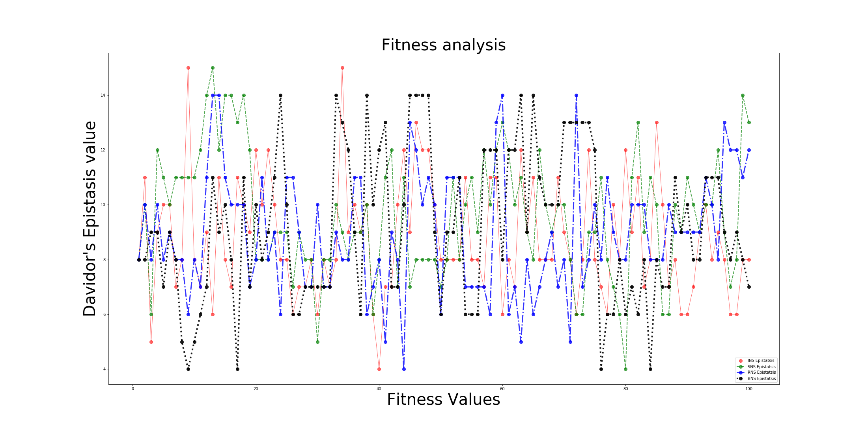
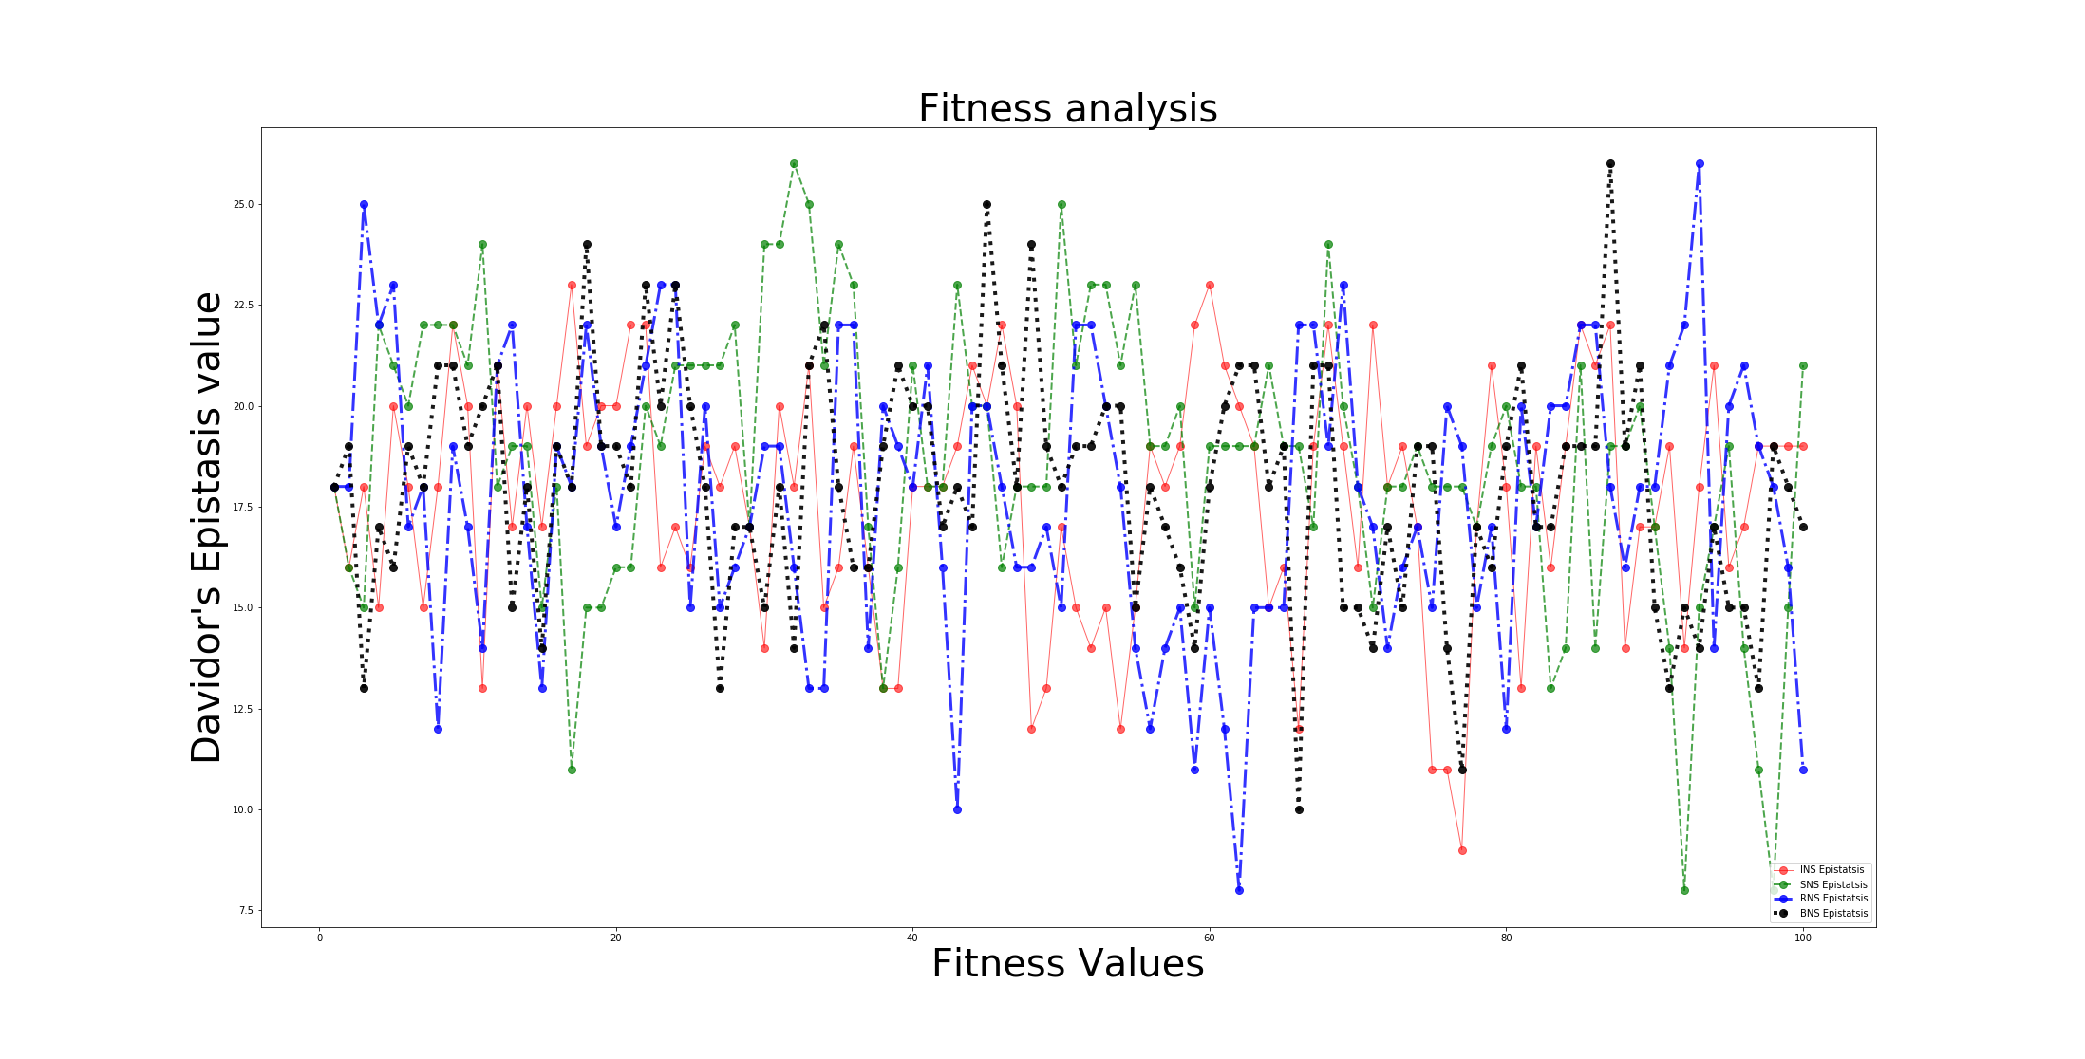
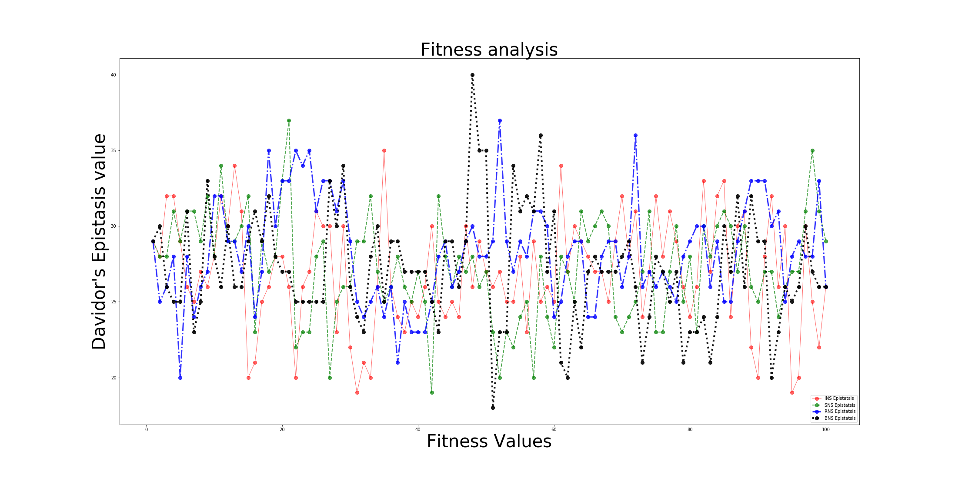
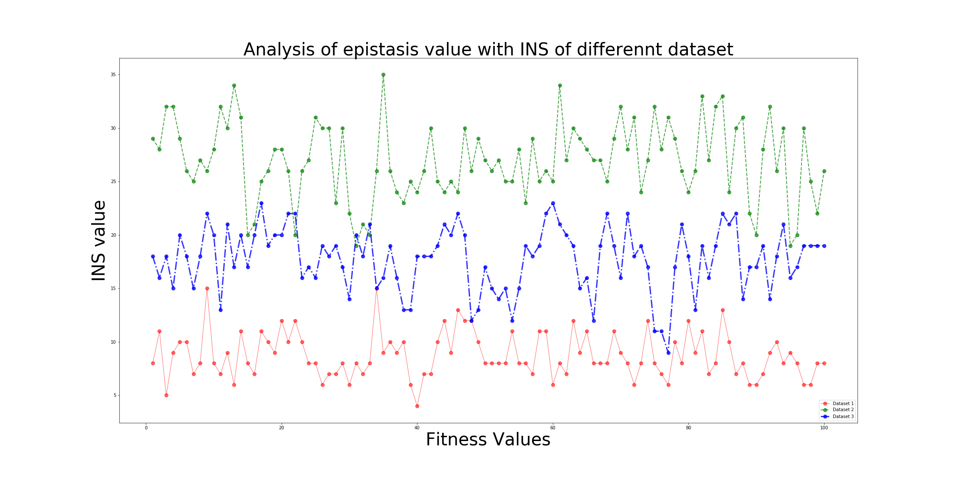
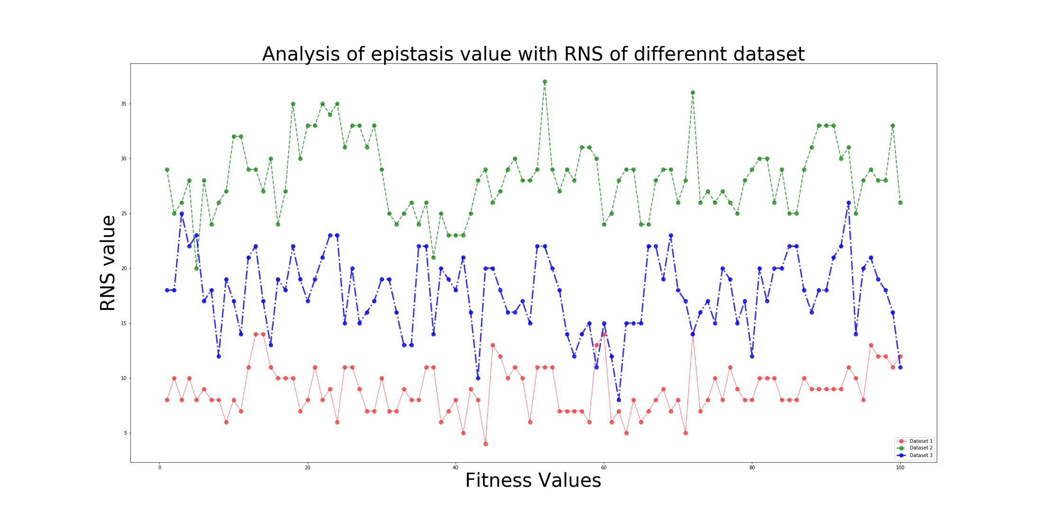
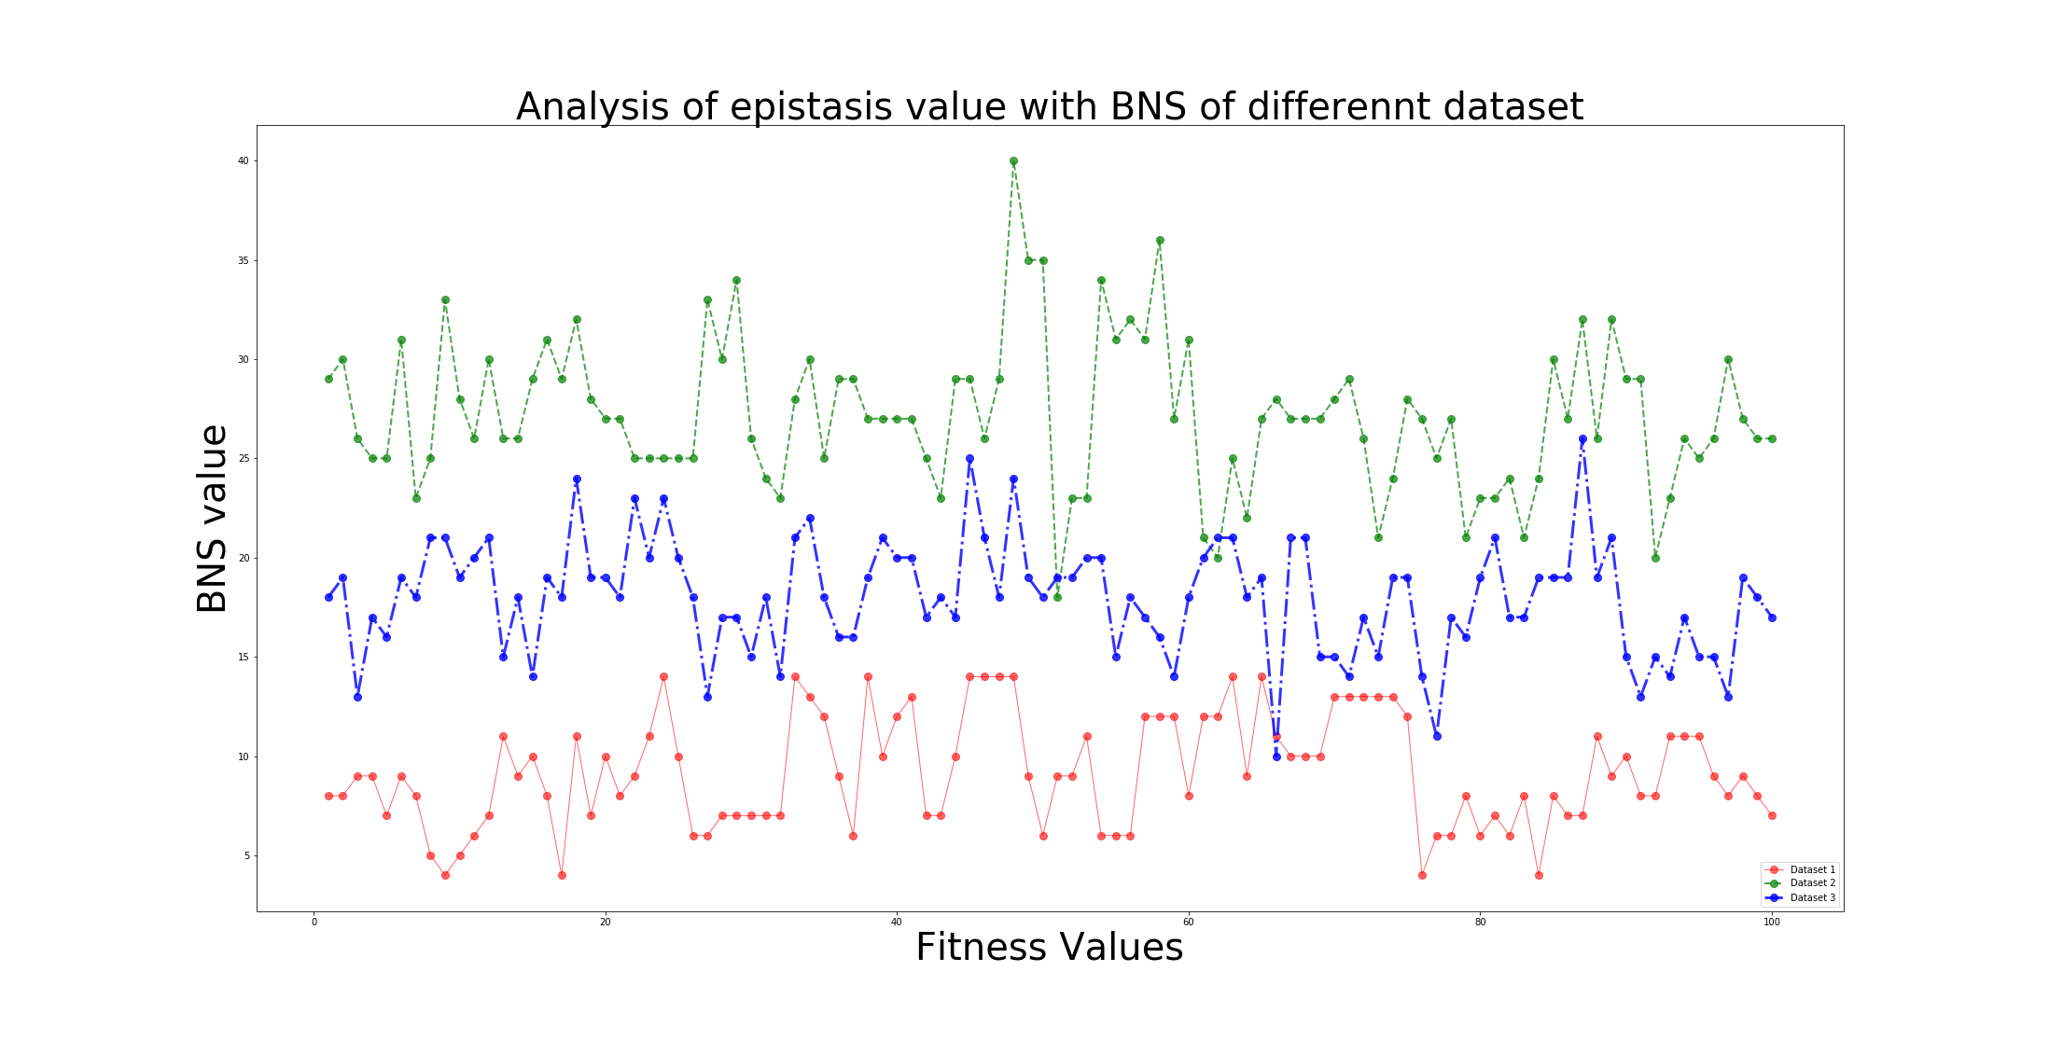
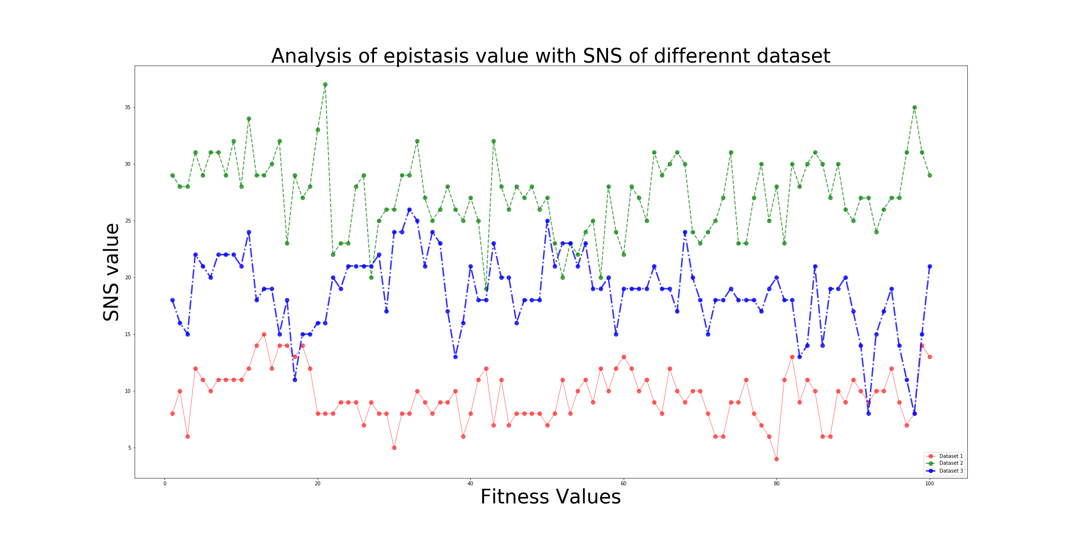
Result and Discussion
Davidor’s epistasis for BNS, INS, RNS and SNS neighborhood structure of each benchmark respectively
Comparison of epistatic variance of 3 benchmarks of each BNS, INS, RNS and SNS neighborhood structures

Slide 15
Result and Discussion
To observe this phenomenon, we have considered 1% of the random solutions generated by the random walk defined here and calculated their epistatic variance and Davidor’s epistasis measure and plotted in the graph.
It is observed that INS representation shows most representation whereas RNS shows most vitiation for all of the benchmark problems. This phenomenon concretes the assumption that the general landscape is like a flat valley with existence of many local optima.
By taking the Davidor’s epistasis of the BNS, INS, RNS and SNS neighborhood with all three benchmark problems, we have plotted graphs .
These graphs exhibits the epistatic variance of the three datasets for all four neighborhood structures and the changes of only magnitude epistasis measures have been observed as all the epistasis values are greater than 0.
.

Slide 16
Conclusion
The macro-level analysis of the evolutionary algorithm to a job shop scheduling problem with sample data sets has been defined. As fitness landscape analysis has been devised as a general method for problem understanding, here we have demonstrated the landscape analysis by choosing random solutions from neighbourhood structures where the results are being analyzed by plotting graphs between permutations and their epistasis values as well as between neighbourhood structures. An ample survey of this random walk method showed the disparity and diversity of the results from different neighbourhood structures elucidating different aspects of optimizations.

Slide 17
Future Work
In this project work, we have worked on the fitness landscape analysis of the epistatic measurements with the different neighbourhood solutions which actually shows the dependency measurement of the solutions on each other. In the future, detailed fitness landscape analysis can be done on different representations of the job shop scheduling problem and its variants like neutral network, ruggedness. Also epistasis based performance study on any evolutionary algorithm on the JSSP. Based on the state-of-the-art autoML or deep learning techniques, a selection strategy algorithm can be designed for the JSSP. The trained solutions from this paper work can be further provided to receive an optimized model as output in the autoML system. This autoML ensemble strategy formulation will help to select an appropriate evolutionary operator in the memetic algorithm framework.

